Slide 1


COMP90049 Knowledge Technologies
Data Mining (Lecture Set 3)
Rao Kotagiri
School of Computing and Information Systems
The Melbourne School of Engineering
Some of slides are derived from Prof Vipin Kumar and modified, http://www-users.cs.umn.edu/~kumar/

Slide 2
What is (not) Data Mining?
What is not Data Mining?
  data base or Web type quires such as “Who is the president of USA in 2011?”
What is Data Mining?
Data analysis leading to the observations such as
  “smoking is a primary cause of increase in lung cancer incidents”
Notes:
Interested in discovery
Methods is more important to come up with these informations

Slide 3
Databases, Data Mining, Machine Learning and Statistics and their relationships
Data mining exploits concepts from databases (scalability, semantics), AI (heuristics), Statistics (significance analysis, distributions, etc.), Machine learning (various clustering, classification, regression, etc.) and Pattern mining (image processing).
Some of the goals of Data Mining are:
  to handle large, high dimensional and complex data (relational, time series, graphical, text, etc.)
  to discover interesting patterns that can help understand underlying process
  to discover knowledge that is useful/actionable
Statistics
and AI
Machine Learning/
Pattern
Recognition
Data Mining
Databases
Notes:
Large database, statistics will give you confidences
AI: complex questions solved by Heuristics: learned by simple algorithms or observed by nature
ML gives clustering classifications regression
Some ideas come up with some observations.

Slide 4
Data Mining Tasks involve
Prediction Methods (supervised learning methods)
  Use some variables to predict unknown or future values of other variables.
  Classification
  Regression
Deviation Detection (outlier detection, anomaly detection)
Description Methods (unsupervised learning)
  Find human-interpretable patterns that describe the data.
Clustering
Association Rule Discovery
Sequential Pattern Discovery
From [Fayyad, et al.] Advances in Knowledge Discovery and Data Mining, 1996
Notes:
Example： Medical classification
Regression: predict a particular value, a student: predict the score of KT course
predict temperature
Deviation detection: very normal, something bad happens, for example, a student grades are all good, but the grade of KT is super low, =➔ deviation detection
I live in Melb, but the banking detects that I withdraw money in China
Something strange happens, use deviation detection to predict
Anomaly: doesn’t mean error, maybe sth special
Clustering:
Group one similar data
Association Rule:
Sequential Rule: predicts the person will buy sth
Credict card doen’t link what you buy

Slide 5
What is classification?
Given a collection of training data
  Each item of the data contains a set of attributes (features), at least one of the attributes is the class.
The goal is to a model for class attributes (dependent variables) as a function of the values of other attributes (independent or decision variables).
The discovered model (function) is used to predict the label of a previously unseen item.
  For determining how good the discovered model is a test set is used. Usually, the given data set is partitioned into two disjoint training and test sets. The training set is used to build the model and the test set is used to validate it by for example the % of the time the class label is correctly discovered.
Notes:
Use features to predict the class

Slide 6


Classification Example
categorical
continuous
categorical
class
Test
Set
Learn
Classifier
Training
Set
Model

Slide 7
Classification: Application 1
Direct Marketing
  Goal: Reduce cost of mailing by targeting a set of consumers likely to buy a new cell-phone product.
  Approach:
    Use the data for a similar product introduced before.
    We know which customers decided to buy and which decided otherwise. This {buy, don’t buy} decision forms the class attribute.
    Collect various demographic, lifestyle, and company-interaction related information about all such customers.
    Type of business, where they stay, how much they earn, etc.
    Use this information as input attributes to learn a classifier model.
Notes:
Target to individual who attempt to buy

Slide 8
Classification: Application 2
Fraud Detection
  Goal: Predict fraudulent cases in credit card transactions.
  Approach:
    Use credit card transactions and the information on its account-holder as attributes.
    When does a customer buy, what does he buy, how often he pays on time, etc.
    Label past transactions as fraud or fair transactions. This forms the class attribute.
    Learn a model for the class of the transactions.
    Use this model to detect fraud by observing credit card transactions on an account.

Slide 9
Classification: Application 3
Sky Survey Cataloging
  Goal: To predict class (star or galaxy) of sky objects, especially visually faint ones, based on the telescopic survey images (from Palomar Observatory).
      3000 images with 23,040 x 23,040 pixels per image.
  Approach:
    Segment the image. (Group similar pixels in an image)
    Measure image attributes (features) - 40 of them per object.
    Model the class based on these features.
    Success Story: Could find 16 new high red-shift quasars, some of the farthest objects that are difficult to find!
From [Fayyad, et.al.] Advances in Knowledge Discovery and Data Mining, 1996
Notes:
Ture one in NASA

Slide 10



Classifying Galaxies
Courtesy: http://aps.umn.edu
Class:
Stages of Formation
Early
Attributes:
Image features,
Characteristics of light waves received, etc.
Intermediate
Late
Data Size:
72 million stars, 20 million galaxies
Object Catalog: 9 GB
Image Database: 150 GB

Slide 11
Clustering Definition
Given a set of data points, each having a set of attributes, and a similarity measure among them, find clusters such that
  Data points in one cluster are more similar to one another.
  Data points in separate clusters are less similar to one another.
Similarity Measures:
  Euclidean Distance if attributes are continuous.
  Other Problem-specific Measures.
Notes:
Similarity: very important, two vectors , the angle is small, we think two vectors are similar

Slide 12
Illustrating Clustering
Euclidean Distance Based Clustering in 3-D space.
Intracluster distances
are minimized
Intercluster distances
are maximized

Slide 13
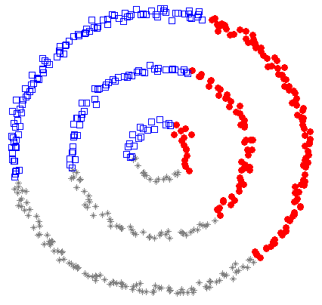
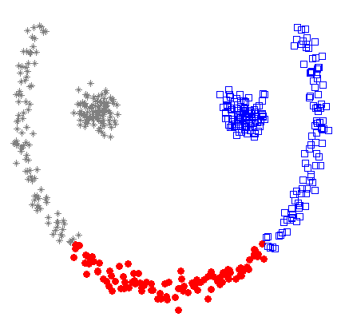
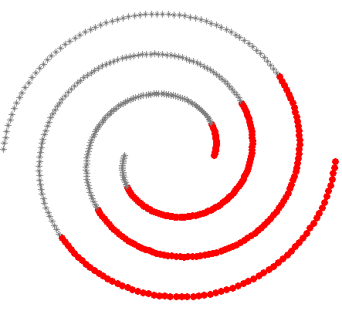
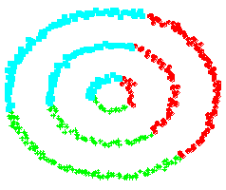
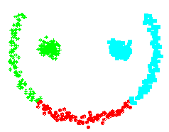
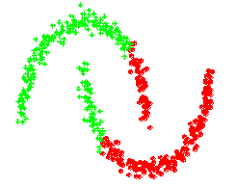
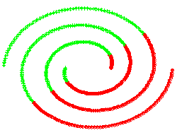
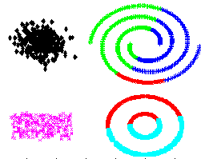
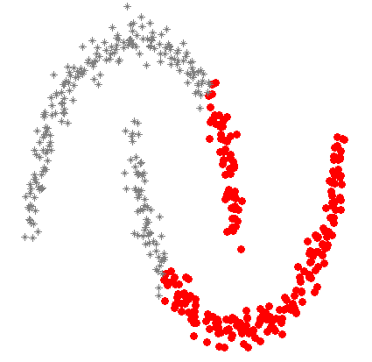
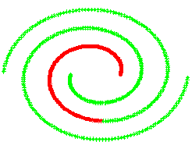
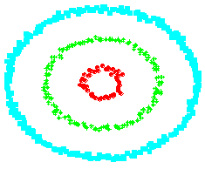
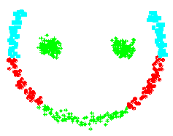
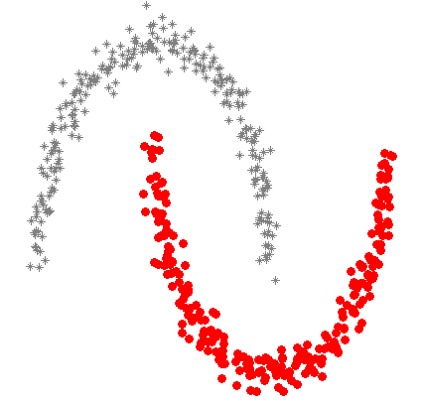
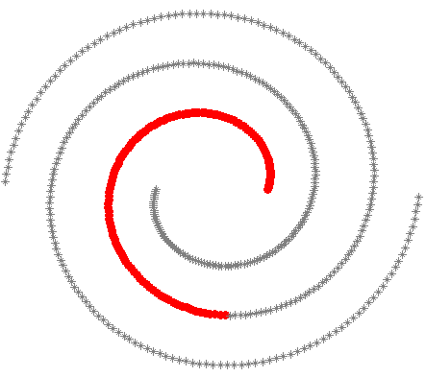
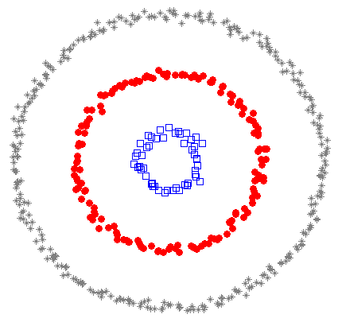
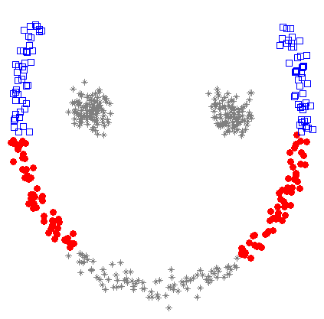
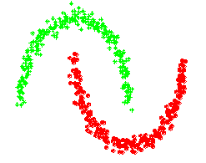
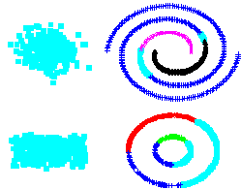
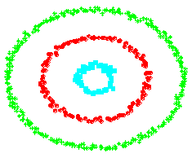
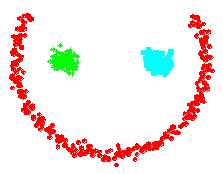
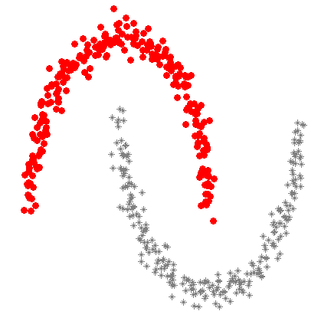
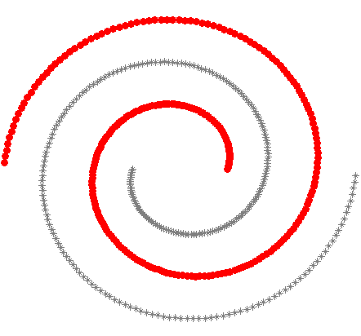
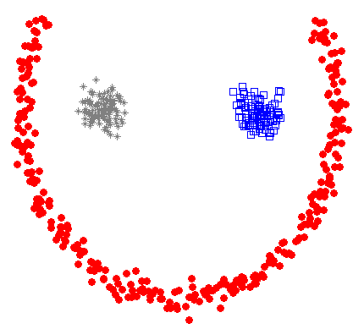
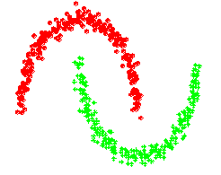
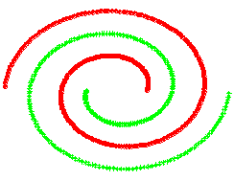
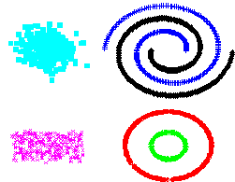
K-means
Spectral clustering
Path based method
Notes:
K means: 3 groups, 2 groups, 6 groups

Slide 14
Clustering: Application 1
Market Segmentation:
  Goal: subdivide a market into distinct subsets of customers where any subset may conceivably be selected as a market target to be reached with a distinct marketing strategy.
  Approach:
    Collect different attributes of customers based on their geographical and lifestyle related information.
    Find clusters of similar customers.
    Measure the clustering quality by observing buying patterns of customers in same cluster vs. those from different clusters.

Slide 15
Clustering: Application 2
Document Clustering:
  Goal: To find groups of documents that are similar to each other based on the important terms appearing in them.
  Approach: To identify frequently occurring terms in each document. Form a similarity measure based on the frequencies of different terms. Use it to cluster.
  Gain: Information Retrieval can utilize the clusters to relate a new document or search term to clustered documents.
Notes:
Key terms hit to documents

Slide 16
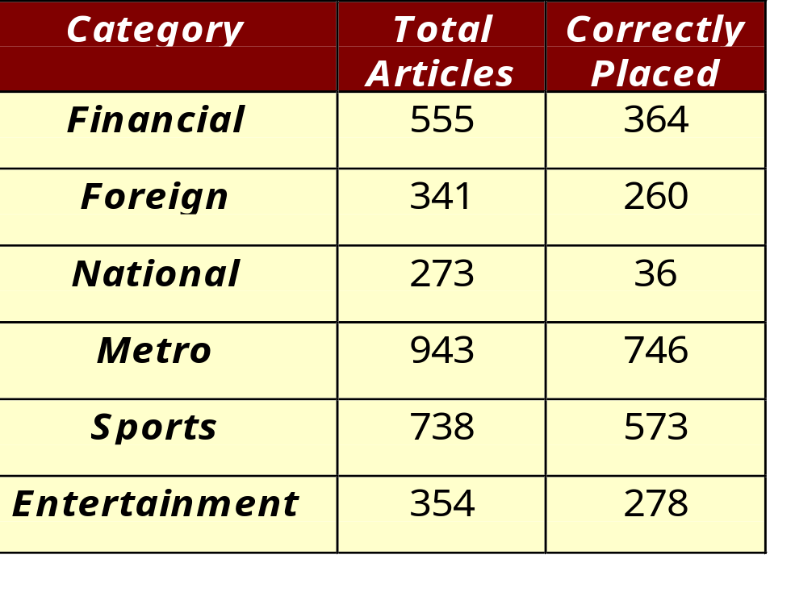
Illustrating Document Clustering
Clustering Points: 3204 Articles of Los Angeles Times.
Similarity Measure: How many words are common in these documents (after some word filtering).

Slide 17
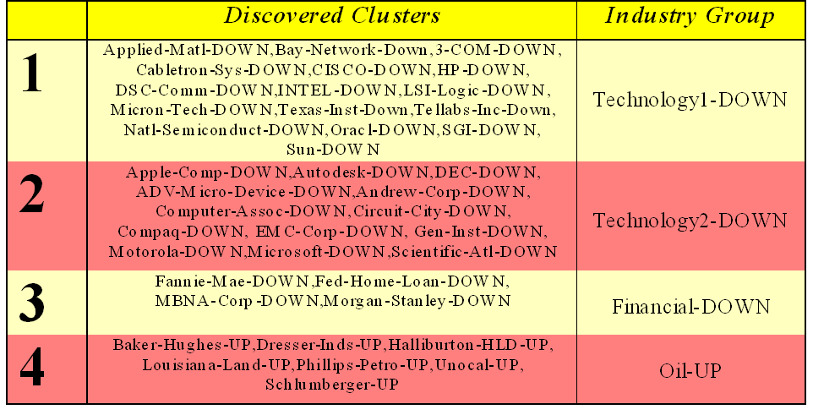
Clustering of S&P (Standard & Poor’s) 500 Stock Data
Observe Stock Movements every day.
Clustering points: Stock-{UP/DOWN}
Similarity Measure: Two points are more similar if the events described by them frequently happen together on the same day.

Slide 18
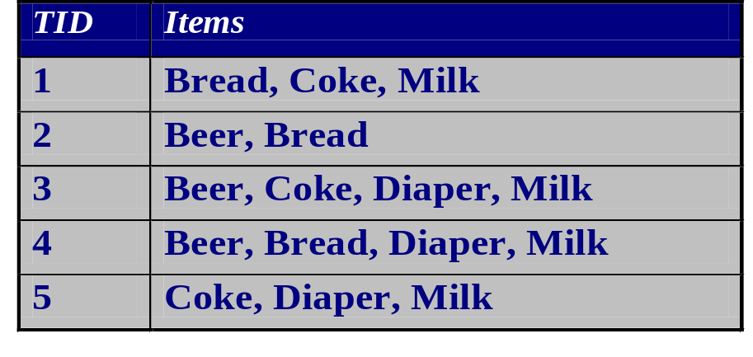
Association Rule Discovery: Definition
Given a set of records each of which contain some number of items from a given collection;
  Produce dependency rules which will predict occurrence of an item based on occurrences of other items.
Rules Discovered:
{Milk} --> {Coke}
Confidence for the rule = #transactions containing Milk and Coke / #transactions containing Milk = ¾
Support for the rule = #transactions containing Milk and Coke /# transactions = 3/5
{Diaper, Milk} --> {Beer}
Confidence = #transactions containing Diaper, Milk and Beer / #transactions containing Diaper and Milk = 2/3
Support for the rule = #transactions containing Diaper, Milk and Beer/ /# transactions = 2/5
Notes:
Confidence: ¾

Slide 19
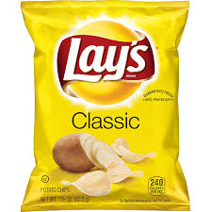
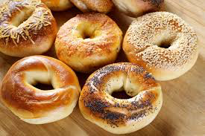
Association Rule Discovery: Application 1
Marketing and Sales Promotion:
  Let the rule discovered be
  {Bagels, … } → {Potato Chips}
  antecedent → consequent
  Potato Chips as consequent => Can be used to determine what should be done to boost its sales.
  Bagels in the antecedent => Can be used to see which products would be affected if the store discontinues selling bagels.
  Bagels in antecedent and Potato chips in consequent => Can be used to see what products should be sold with Bagels to promote sale of Potato chips!

Slide 20
Association Rule Discovery: Application 1
Marketing and Sales Promotion:
→
  Let the rule discovered be
  {Bagels, … } → {Potato Chips}
  antecedent → consequent
  Bagels in antecedent and Potato chips in consequent => Can be used to co-locate Bagels and Potato Chips to further boost the sales of both products. Bagels in antecedent and Potato chips in consequent => The store may reduce the price of Bagels to actually increase the profit by increasing price Potato chips!

Slide 21
Association Rule Discovery: Application 2
Inventory Management:
  Goal: A consumer appliance repair company wants to anticipate the nature of repairs on its consumer products and keep the service vehicles equipped with right parts to reduce on number of visits to consumer households.
  Approach: Process the data on tools and parts required in previous repairs at different consumer locations and discover the co-occurrence patterns.

Slide 22
Sequential Pattern Discovery: Definition
Given a set of objects, with each object associated with its own timeline of events, find rules that predict strong sequential dependencies among different events.
Rules are formed by first discovering patterns. Event occurrences in the patterns are governed by timing constraints.
(AB) (C) (D E)
(AB) (C) (D E)
<= T1
> T2
<= T3
<= T4
Notes:
Time sequencing

Slide 23
Sequential Pattern Discovery: Examples
In telecommunications alarm logs,
  (Inverter_Problem) ( Excessive_Line_Current) (Rectifier_Alarm) → (Fire_Alarm)
In point-of-sale transaction sequences,
  Computer Bookstore:
  (Intro_To_Visual_C) (C++_Primer) → (Perl_for_dummies,Tcl_Tk)
  Athletic Apparel Store:
  (Shoes) (Racket, Racketball) → (Sports_Jacket)

Slide 24
Regression
Predict a value of a given continuous valued variable based
on the values of other variables, assuming a linear or
nonlinear model of dependency.
Greatly studied in statistics, neural network fields.
Examples:
  Predicting sales amounts of new product based on advertising expenditure.
  Predicting wind velocities as a function of temperature, humidity, air pressure, etc.
  Time series prediction of stock market indices.
Notes:
Medical cases popular

Slide 25





Deviation/Anomaly Detection
Detect significant deviations from normal
behavior
Applications:
  Credit Card Fraud Detection
  Network Intrusion
  Detection
Typical network traffic at University level may reach over 100 million connections per day

Slide 26
Challenges of Data Mining
Scalability with respect to size (number of data points) and
dimensionality (number of features)
Complex and Heterogeneous Data
Data Quality
Data Ownership and Distribution
Privacy Preservation
Streaming Data
Incremental learning
How to combine domain knowledge with Data Mining
Understandability of the models discovered
Notes:
Incremental learning: very expensive, therefore, learn slowly

